Slide 1
Pls 2000 power & politics dr. shannon
Identity Politics I:
Race and Ethnicity

Slide 2
Identity politics I
I. IDENTITY: RACE & ETHNICITY
II. INTERCULTURAL STRATEGIES OF SOCIETY
III. RACIAL POLITICS IN THE USA
TERMS TO KNOW
Assimilation Status Threat Plessy v. Ferguson Brown v. Board of Ed
Booker T. Washington Marcus Garvey Interculturalism MLK
Multiculturalism Black Nationalism Voting Rights Act (VRA) 13th Amendment
Apartheid Hate Crime CRT 15th Amendment
Liberal Integrationism Black Conservatism Muted Groups

Slide 3
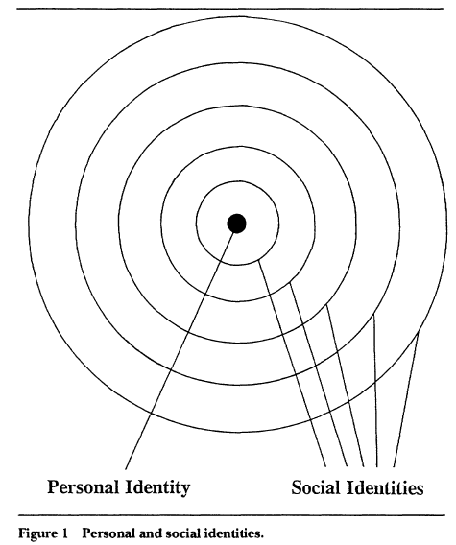
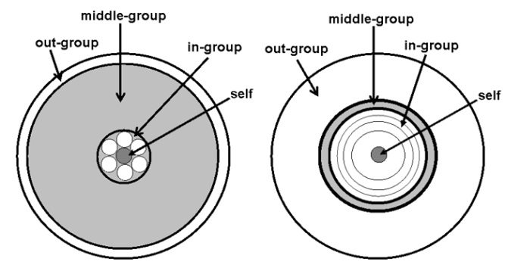
I. IDENTITY: RACE & ETHNICITY
Identity: That part of an individual’s self-concept derived from the value of membership in a social group
Characteristics of Identity:
Salience: which identity matters when
Strength (intensity of attachment)
Content (group norms)
Boundaries (membership): In-group & Out-group
Nature or culture?
Your choice or chosen by others?
http://www.russellsage.org/visiting-scholars/susan-t-fiske-interview

Slide 4
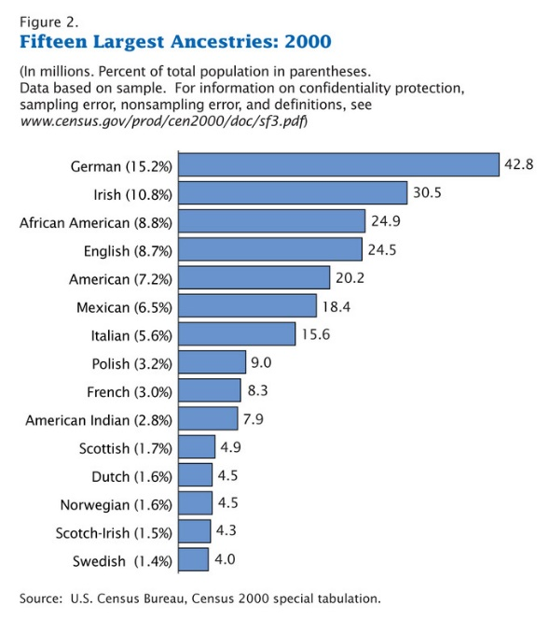
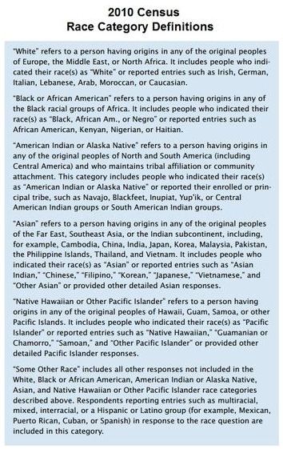
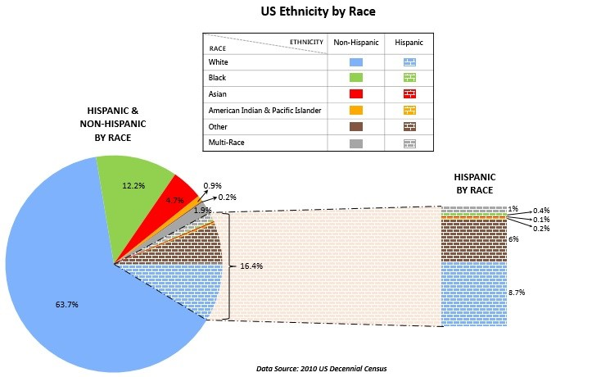
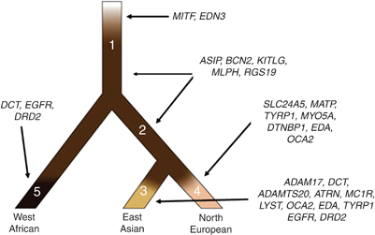
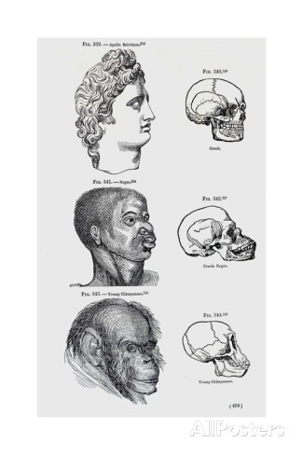
RACE & ETHNICITY
Nationality: citizenship or descent based on country or historical land
Ethnicity: membership in an “ascriptive category – race, language, religion, country of origin- that includes “cultural and psychological roots based on historical or shared backgrounds” (Holmsten)
Race: A social construct of a group of people argued to share similar, distinct characteristics
Biological Essentialism: taxonomies of groupings based on perceived traits deemed genetically or biologically based, categorically distinct, and associated with behaviors or aptitudes (Madison Grant’s Passing of the Great Race: “Adolf Hitler’s Bible” - Serwer 2019)
Scientists affirm one human race genetically diversified due to environment and mating, and disavow racial explanations for collective differentiation in physical and behavioral traits
https://www.census.gov/data-tools/demo/race/MREAD_1790_2010.html
http://www.nature.com/milestones/skinbio4/full/skinbio20113a.html
https://statchatva.org/2014/11/04/what-race-are-hispanics/
Herrmann Konversationslexikon (1885–1892), Public Domain, https://commons.wikimedia.org/w/index.php?curid=1094904
http://www.nerdgranny.com/wp-content/uploads/2009/09/skin-color-evo.gif
https://en.wikipedia.org/wiki/Race_(human_categorization)
https://www.aecf.org/blog/what-the-data-say-about-race-ethnicity-and-american-youth

Slide 5
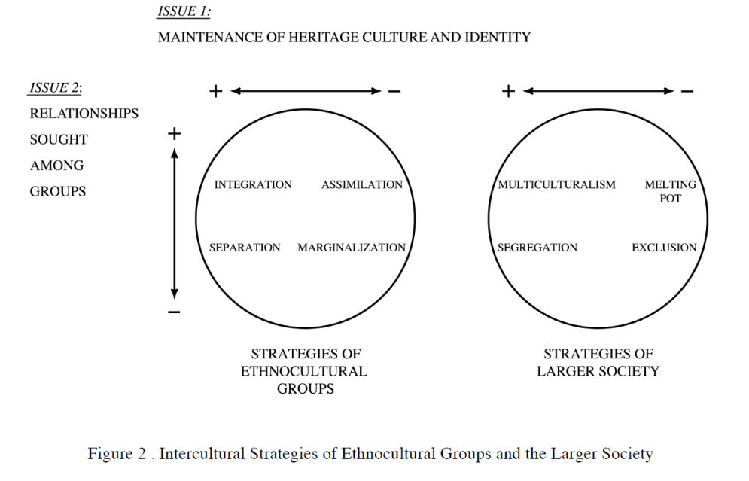
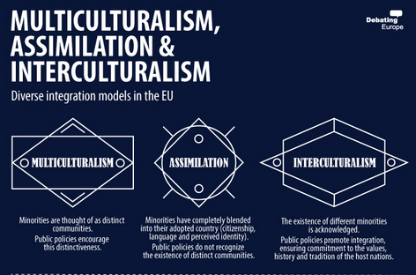
ii. Intercultural strategies of society
How to Manage relationships among majority & minority groups
Multiculturalism (p.146-8)
Group rights to protect minority communities from “eroding effects of individual autonomy”
Self-governance (territorial autonomy), Polyethnic (languages, customs) and Representative rights (quotas, reserved seats)
cultural hegemony as discriminatory and fostering minority resentment
Melting Pot (Assimilation):
Common framework enforced for all equally; minorities not recognized
Opposes multiculturalism as “corrosive of long-term political unity and social stability” (p.148)
Interculturalism
Liberalism and “reasonable pluralism” (p.147)
https://lanekenworthy.net/tolerance/

Slide 6
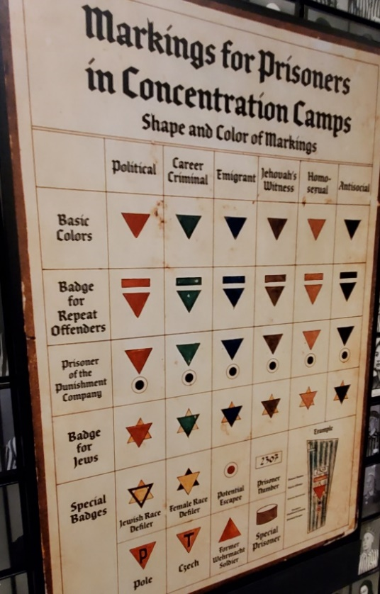
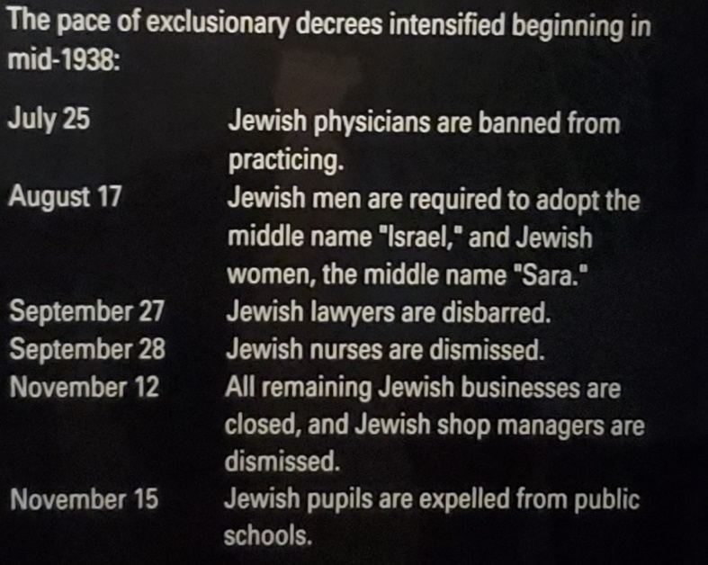
ii. Intercultural strategies of society
How to Manage relationships among majority & minority groups
Exclusion
Nazi Germany & Fascist Italy: ghettos, racial hierarchy, concentration camps and the Final Solution
https://lanekenworthy.net/tolerance/
https://link.springer.com/article/10.1007/s11199-008-9424-4

Slide 7
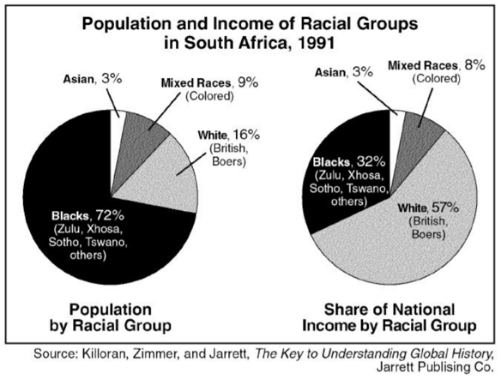
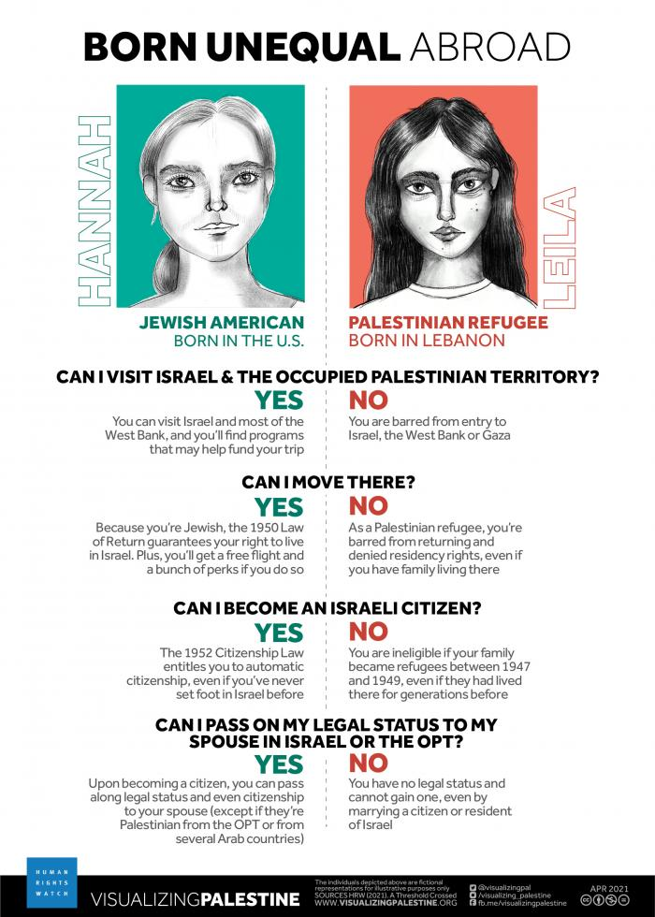
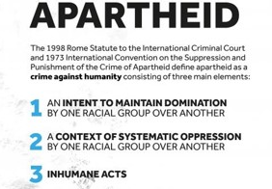
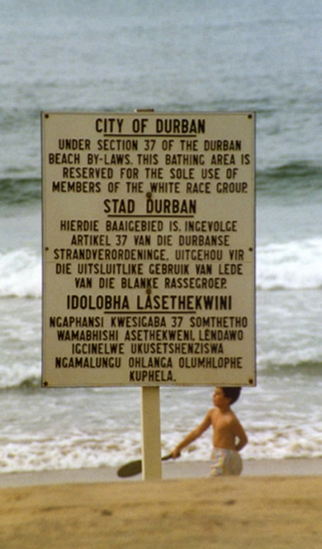
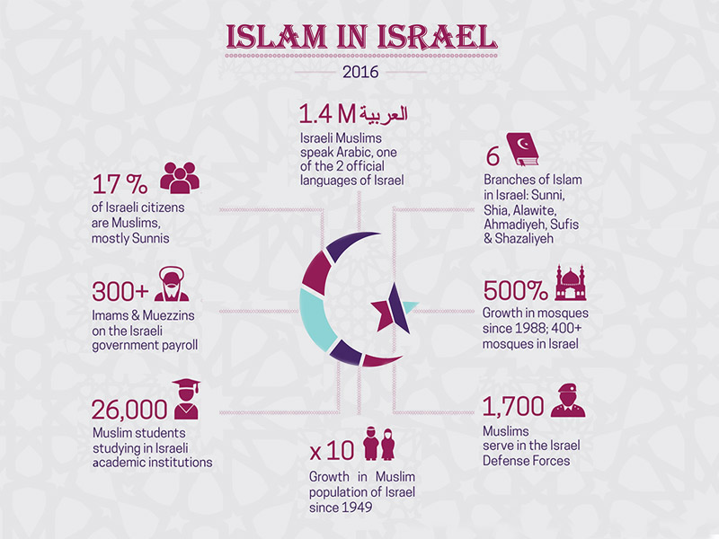
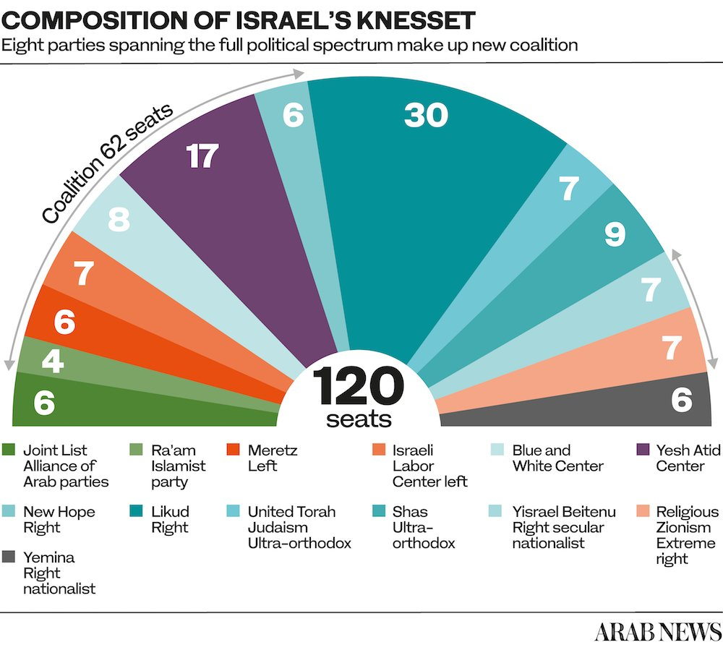
ii. Intercultural strategies of society
Segregation
Apartheid South Africa: racialized classes and segregation
Israel? Multicultural democracy or Jewish supremacy and Palestinian oppression?

Slide 8
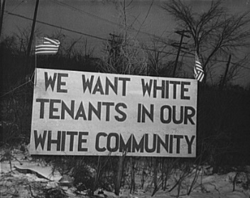
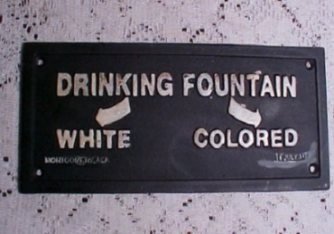
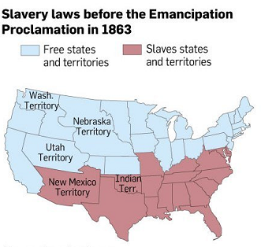
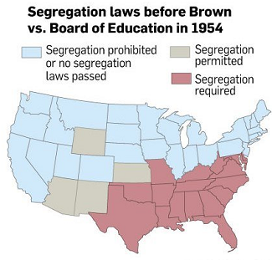
Segregation in the usa
America’s “rival principles of national unity”: (1) the U.S. is the champion of the poor and the dispossessed, a nation that draws its strength from its pluralism, but (2) America’s greatness is the result of its white and Christian origins, the erosion of which spells doom for the national experiment. (Serwer 2019)
Not Full Citizens: Slavery, 3/5 Compromise & Dred Scott Decision
The Free North? “African Americans…were active participants in society, enlisted as soldiers, fought in the American Revolution; owned land, homes, businesses, and paid taxes. In some cities, for brief periods of time, black property owners voted.”
“Free, yet never fully free, frozen in a state of civic ambiguity…included in the census as residents but nothing more”
Segregationist South
Plessy v. Ferguson (1896): Plessy’s one great grandparent was black, and he was imprisoned for sitting in the white section of a train
Court ruled Separate But Equal is constitutional
Brown v. Board of Education (1954) ends separate but equal
https://www.loc.gov/exhibits/african-american-odyssey/free-blacks-in-the-antebellum-period.html
https://www.yourvoteyourvoicemn.org/past/communities/african-americans-past/voting-rights-civil-war

Slide 9
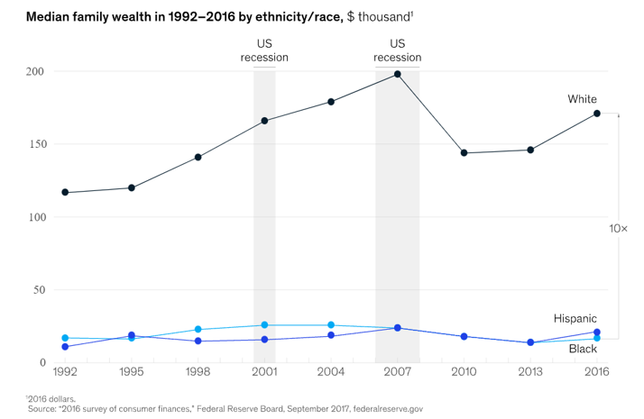
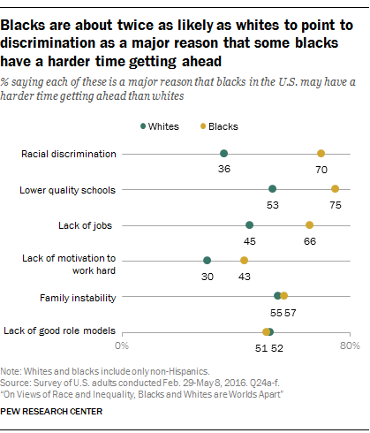

iiI. racial politics in the usa
Why Racial Political, Economic and Social Disparities?
Black political thought:
a set of critical tools to help explain the political distinctiveness of black life-worlds and how this distinctiveness is structured by relations between individual and community, state and society
race as a relational concept, a dynamic interaction between two or more putatively distinct groups
racism as conditioned & articulated through politics: distinctive trajectories of black politics emerged from spaces of exclusion and subordination in Western polities.
How black peoples have conceptualized, created and engaged in politics, political communities, and their articulation: Strategies of Ethnocultural minorities
https://slate.com/culture/2021/06/woke-critical-race-theory-definition-history-meaningless.html
mckinsey.com/industries/public-and-social-sector/our-insights/the-economic-impact-of-closing-the-racial-wealth-gap
https://journals.sagepub.com/doi/abs/10.1177/0090591710366379

Slide 10
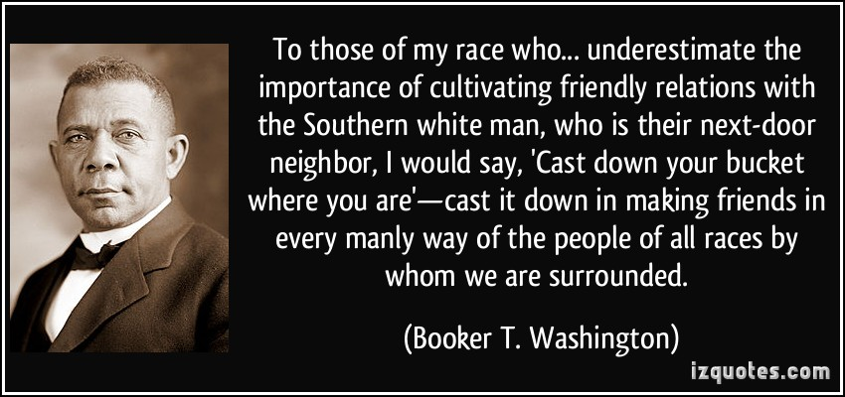
BLACK POLITICAL THOUGHT
BLACK CONSERVATISM: locates black inequality in the behavioral or attitudinal pathologies of African Americans and stresses the significance of moral and personal characteristics.
self-reliance and assimilation into a colorless society shunning government assistance in favor of economic strategies of self-help
Distrustful of the state and rejects policy strategies that diminish the African Americans by allowing a perception of undeserved benefits.
Rooted in a history of racial uplift, a belief that African Americans must fortify their moral and economic strength to compete in the American meritocracy.
Booker T. Washington: “Cast Down Your Bucket Where You Are”
Accomodationist philosophy to instill a work ethic and manual with the promise of making African Americans profitable members of society. Emphases on thrift, industriousness, and moral character.
https://go.gale.com/ps/i.do?p=GVRL&u=dayt38887&id=GALE|CX3444701016&v=2.1&it=r&sid=bookmark-GVRL&asid=64a84770
https://slate.com/culture/2021/06/woke-critical-race-theory-definition-history-meaningless.html
https://journals.sagepub.com/doi/abs/10.1177/0090591710366379

Slide 11
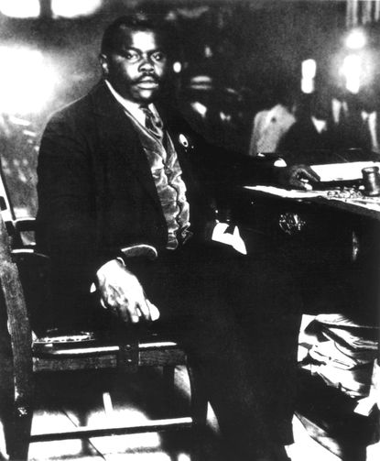
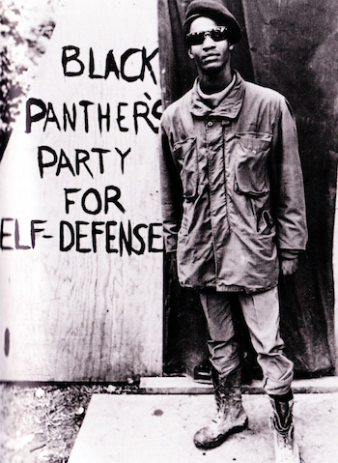
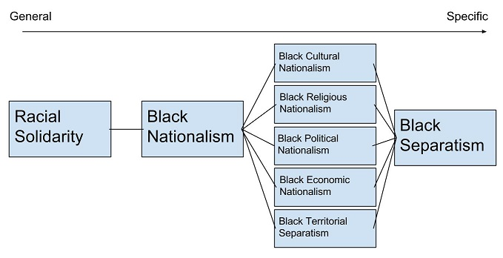
Black nationalism
advocates of consciousness and solidaritism while pushing for some form of cultural, social, economic, and political autonomy even separatism for Blacks
Perceives whites as resistant to black equality, articulates a language of self-determination and racial pride, and insists on African-American self-reliance through the creation of separate institutions such as schools, churches, political parties, and businesses.
Marcus Garvey’s Universal Negro Improvement Association declared the right and necessity of black separation from oppressive polities by through black pride, political representation, cultural icons, and economic institutions.
Black Panthers advocated development of distinct black-controlled centers of politics, economics, and culture for addressing black inequality.

Slide 12
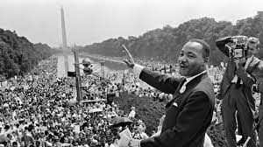
Liberal integrationism
Wants a society in which African Americans enjoy the political, economic, and social freedoms and rights of other citizens.
Accepts tenets of representative democracy, liberalism, and capitalism, but argues the American system only worked for privileged members of society.
Seeks to access that privilege for African Americans by arguing about the equality of constitutional rights.
Reliance on a strong central government for equal opportunity.
Electoral participation, federal litigation, pressure for government-based economic redevelopment, and support for race-targeted government programs.
Civil rights: Frederick Douglass, Martin Luther King Jr, NAACP
https://go.gale.com/ps/i.do?p=GVRL&u=dayt38887&id=GALE|CX3444701016&v=2.1&it=r&sid=bookmark-GVRL&asid=64a84770
https://slate.com/culture/2021/06/woke-critical-race-theory-definition-history-meaningless.html
https://journals.sagepub.com/doi/abs/10.1177/0090591710366379

Slide 13
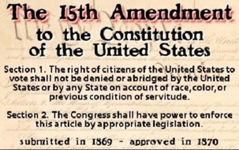
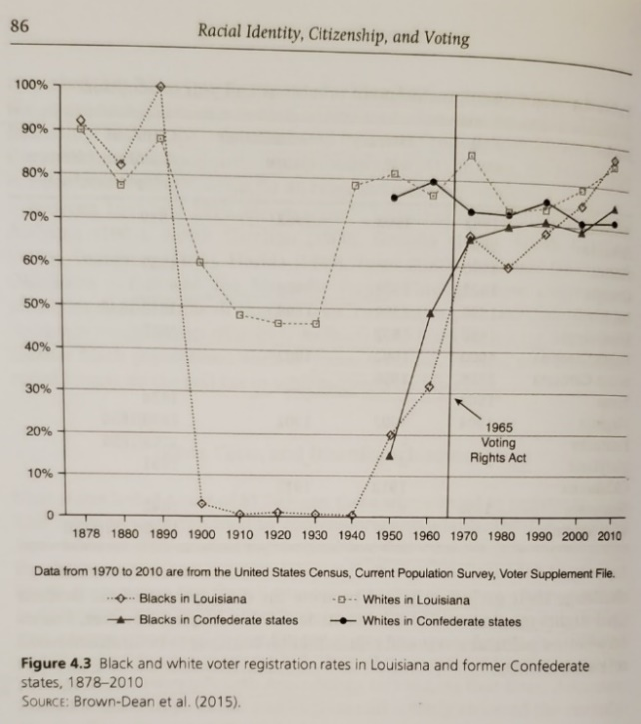
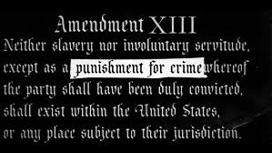
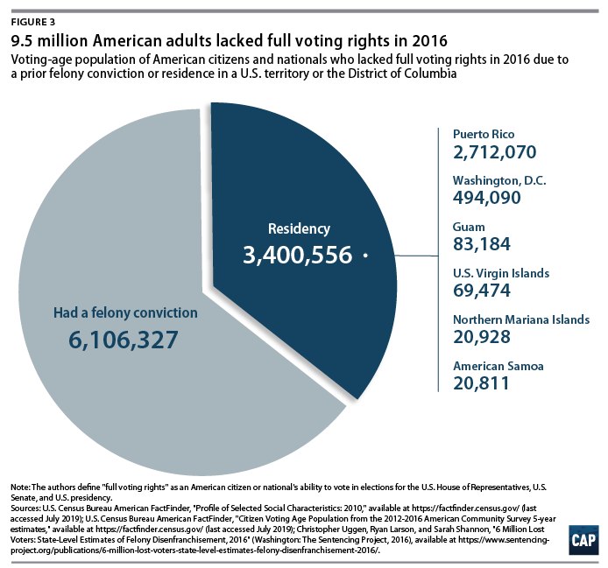
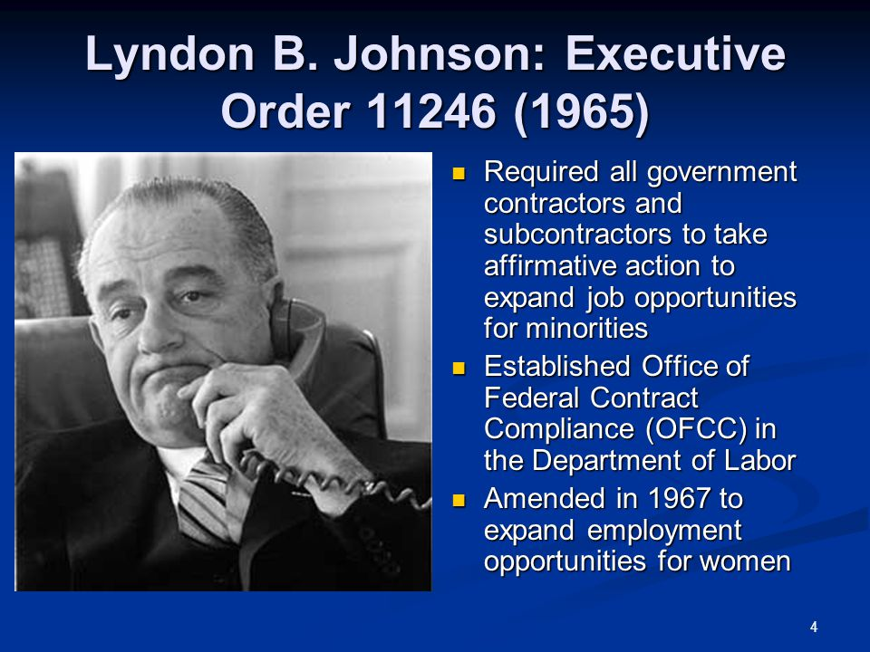
Opportunities & obstacles
Voting
15th Amendment
Jim Crow Laws limited voting with poll taxes, literacy tests, property requirements & grandfather clause
Voting Rights Act (1965) bars voting procedures that "result in a denial or abridgment of the right of any citizen of the US to vote on account of race or color."
2013: Court overturns VRA provision requiring state & local governments w/history of racial voting discrimination get federal approval to change voting procedures.
2021: AZ law prohibits ballot collectors & ballots cast in wrong precincts: Supreme Court rules “Disparity in impact does not necessarily mean a system is not equally open or that it does not give everyone an equal opportunity to vote”
13th Amendment: Crime & Punishment
Affirmative Action: 1978 U. California v. Bakke says quotas are unconstitutional “reverse discrimination”
https://www.npr.org/2021/07/01/998758022/the-supreme-court-upheld-upholds-arizona-measures-that-restrict-voting
https://www.propublica.org/article/black-children-were-jailed-for-a-crime-that-doesnt-exist

Slide 14
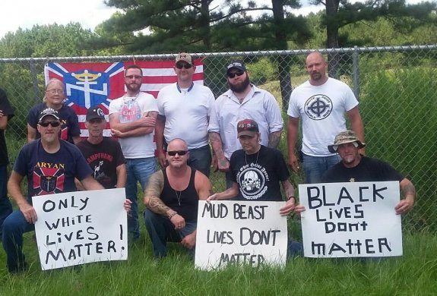
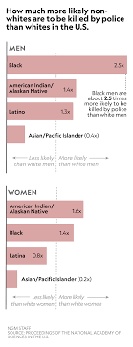
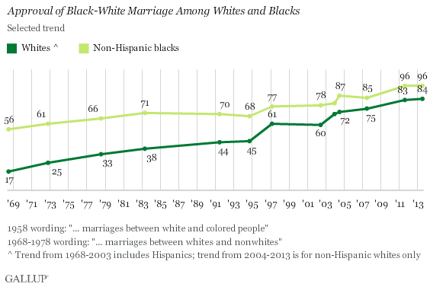
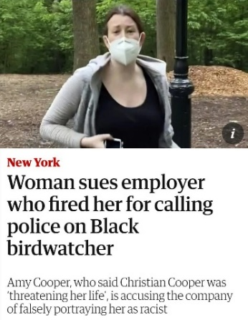
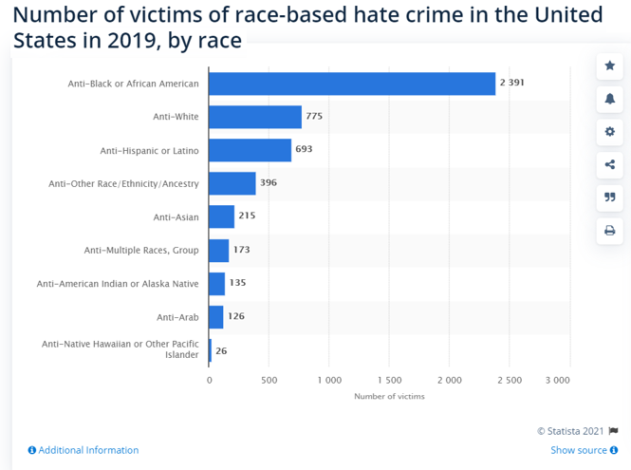
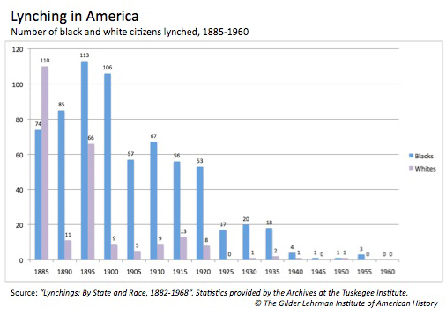
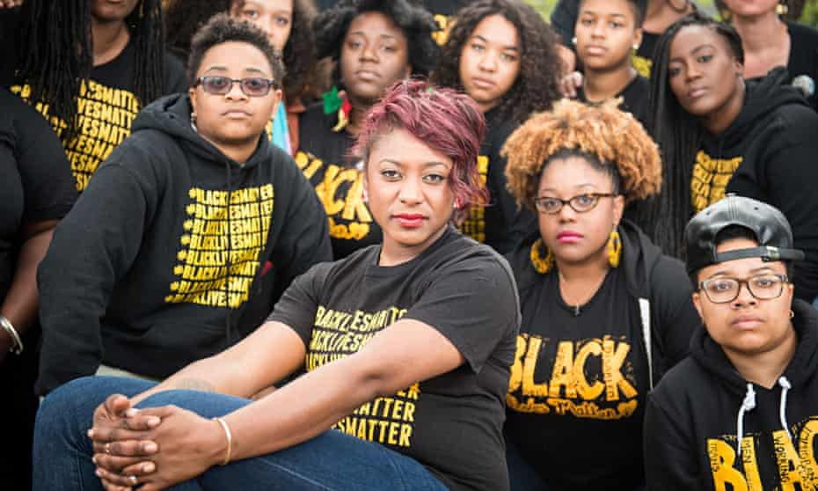
POST-RACIAL, COLORBLIND AMERICA?
Tolerance: Feelings toward groups who differ from you and the belief that those who differ from you have same rights
Racism: a direct and overt prejudice & discrimination
White Nationalism, White Supremacy & White Genocide
Hate Crimes: an illegal act involving intentional selection of a victim based on perpetrator’s prejudice against the actual/perceived status of victim
Status Threat felt by dwindling proportion of traditional high-status groups.
Predicted support for Trump: Feeling the “American way of life is threatened” and people perceive dominant social groups (men, Christians, and whites) as discriminated against more than lower status groups
Aversive Racism: regard selves as egalitarian & nonprejudiced but possess unconscious negative feelings and beliefs about particular minorities
expressed in subtle, indirect ways when guidelines & judgment for appropriate behavior unclear
Police, Violence & Black Lives Matter
How Far? ACAB and Defund the Police
https://www.complex.com/life/2020/05/white-antagonists-getting-in-the-way-black-lives-matter
https://www.pnas.org/content/115/19/E4330
https://www.economist.com/united-states/2016/12/10/the-apparent-rise-in-hate-crime-since-the-election-is-likely-to-be-short-lived
https://www.statista.com/statistics/737690/number-of-racist-hate-crime-victims-in-the-us-by-race/
https://www.statista.com/statistics/737690/number-of-racist-hate-crime-victims-in-the-us-by-race/
https://www.economist.com/united-states/2016/12/10/the-apparent-rise-in-hate-crime-since-the-election-is-likely-to-be-short-lived
https://www.theguardian.com/world/2015/jul/19/blacklivesmatter-birth-civil-rights-movement

Slide 15
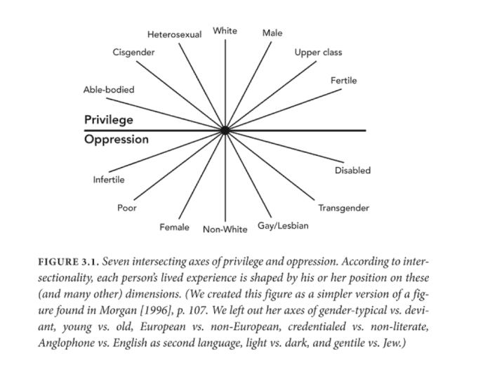
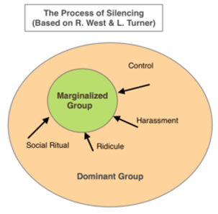
Critical race THEORY (Schaefer 2008)
collection of critical stances against the existing legal order from a race-based point of view: Racism is institutional, systemic and structural to privilege the interests and power of a dominant group against discriminated minority.
Critiquing Liberal Integration: dissatisfied with slow pace of racial reform and seeming inability of liberal thinking to counter the erosion of civil rights accomplishments.
Race Consciousness.—nondiscrimination, equality of opportunity, rule of law helped bring down legalized segregation but equal protection of individuals before the law presents obstacles to those acting against “racial hierarchy”
Standpoint Epistemology: Marginalized/Muted Groups have competence & authority to speak, and must be allowed to speak to expose bias & express lived experience
Object to speech protected irrespective of content. Speech acts linked with contexts of intimidation and violence demands attention in assessment of potential harm such an act might inflict on its intended audience.
https://en.wikipedia.org/wiki/Critical_race_theory

Slide 16
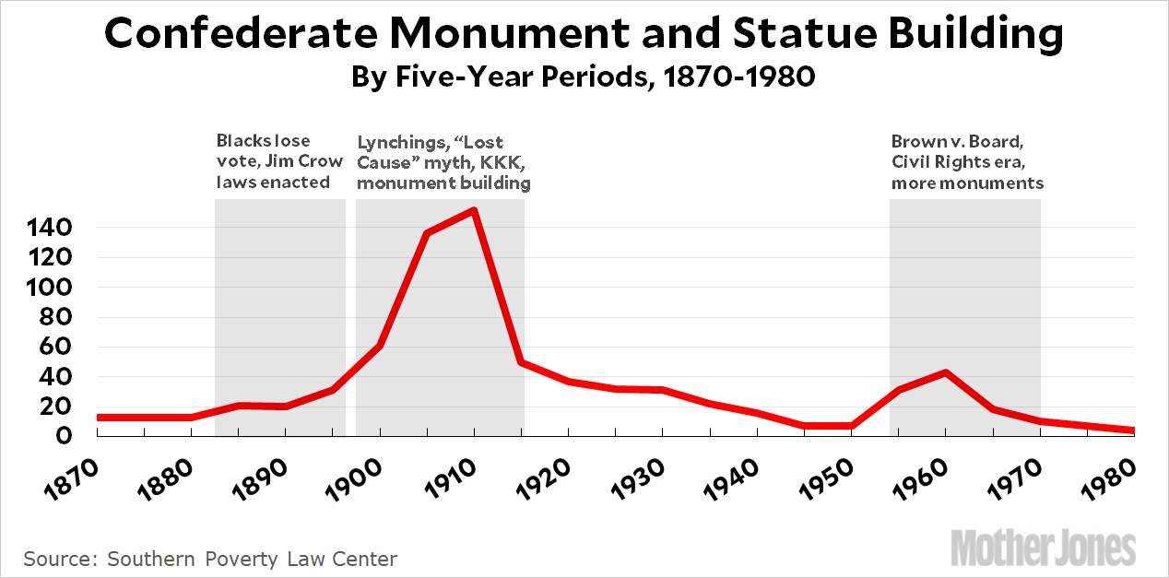
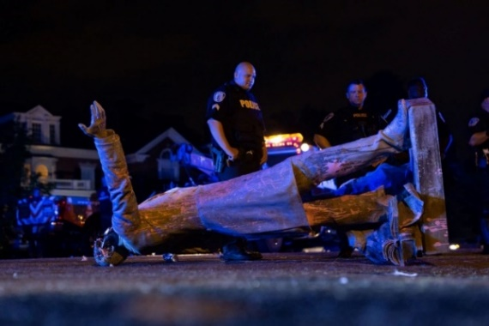
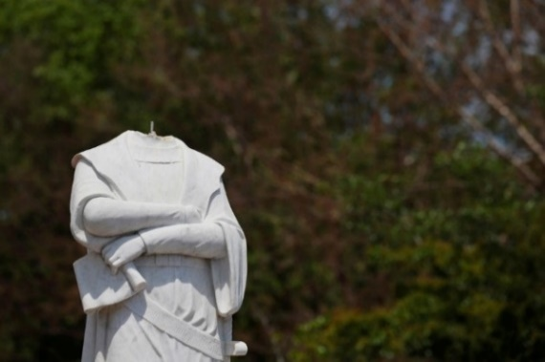
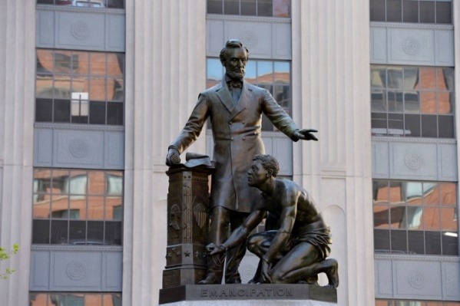
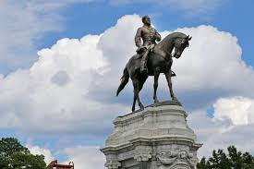
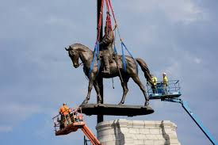
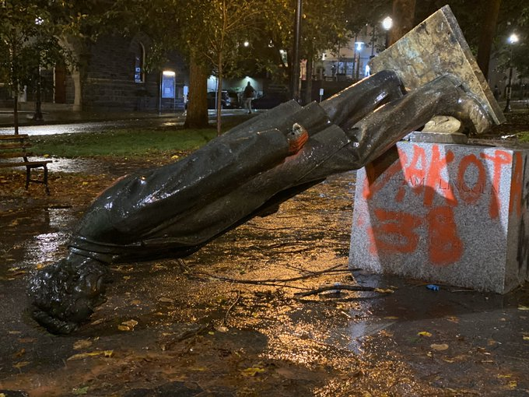
“accountability/cancelling”: How much and by what process?
Who Decides what is inappropriate?
Elected Officials and Courts?
Majority Public opinion
Opinion of targeted, offended community?
Social media trending
What measures are appropriate to deal with the inappropriate?
Apologies
Whatever the law currently entails
Firings, Impeachments, resignations
By what process is the inappropriateness addressed?
Legal means and processes
Social media
The Case of Statues:
Richmond’s Jeffereson Davis Statue pulled down by protesters
Richmond’s Lee Statue: Virginia Gov. calls for removal, Supreme Court upheld. In storage.
Lincoln statue by vote of the Boston Art Commission
Lincoln in Portland by protesters
https://www.theatlantic.com/photo/2020/07/photos-statues-removed-george-floyd-protests-began/613774/
https://www.npr.org/2021/09/08/1035004639/virginia-ready-to-remove-massive-robert-e-lee-statue-following-a-year-of-lawsuit
https://www.opb.org/article/2020/10/12/portland-protesters-tear-down-roosevelt-lincoln-statues-during-day-of-rage/

